Slide 1
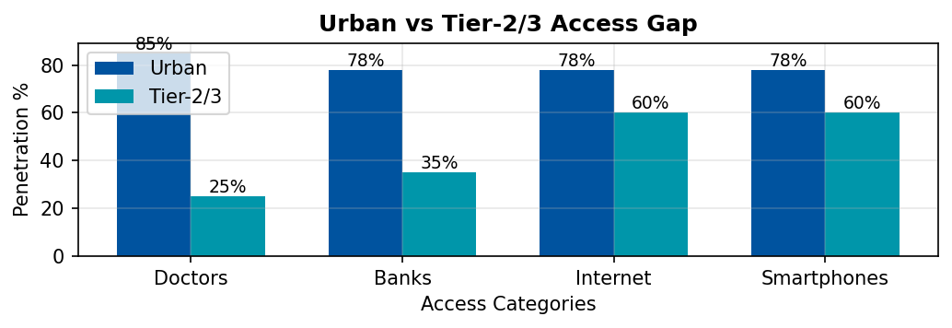
Why Tier-2 & Tier-3 India are Ripe for Disruption
Tier-2 and Tier-3 cities are the new economic frontier.
With rising digital penetration but weak physical infrastructure, these markets are digitally ready yet structurally underserved.
📊 MACRO TRENDS
🚨 UNDERSERVED SECTORS
💰 45% of GDP
by 2025
👥 650M
Population
📱 60%
Smartphone
🏥 Healthcare: 600M underserved
📚 Education: Ratio 1:60 vs 1:30
💳 12B+
UPI/month
📡 $0.17/GB
Data Cost
💰 Finance: 190M unbanked
🌾 Agriculture: ₹90,000 Cr losses
Digital readiness + structural gaps = fertile ground for disruption.
Presented By — Nakul Nandanwar, Vaishnavi Bhangale, Rahul Kumbhare

Slide 2
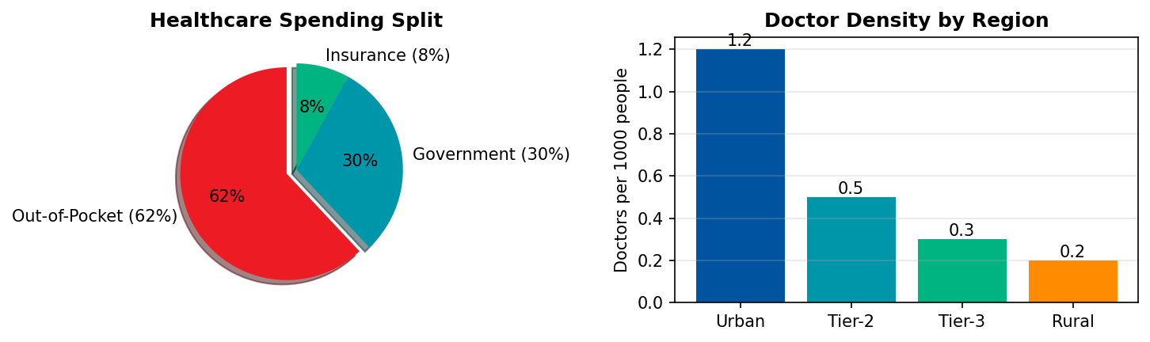
Why Healthcare is the Burning Platform
Among all underserved sectors, healthcare stands out due to its scale, urgency, and proven readiness for digital disruption.
🚫 ACCESSIBILITY
💸 AFFORDABILITY
🧠 AWARENESS & TRUST
75% doctors in urban
600M underserved
Avg 50+ km travel
OOP = 62% spend
60M fall into poverty
yearly from healthcare
Stigma around preventive
& mental care
Reliance on quacks
📊 Healthcare Market: $372B by 2025
22% CAGR
📊 Telemedicine: $5.4B by 2025
45% CAGR
📊 Diagnostics: 20% CAGR
Growing rapidly
📊 eSanjeevani: 160M+ teleconsults
Govt success
Healthcare = urgent problem + massive market potential.
Presented By — Nakul Nandanwar, Vaishnavi Bhangale, Rahul Kumbhare

Slide 3
Competitive Landscape & White Space
Existing players have not solved the affordability + accessibility gap in Tier-2/3 markets, leaving a white space for a vernacular, trust-based model.
Urban + Narrow
🔍 KEY INSIGHTS
Practo
Apollo 24/7
Rural + Narrow
Local clinics
• India spends only 3% of GDP on healthcare vs 9% global avg
• 60% of rural Indians rely on informal practitioners
Service Breadth →
• Telemedicine adoption surged 10x post-COVID
Urban + Broad
1mg
PharmEasy
Rural + Broad
eSanjeevani
Tata Health
WHITE SPACE
• Digital health market CAGR of 39% till 2027
• 75% patients willing to use digital health if affordable
Geography →
🎯 WHITE SPACE = Affordable vernacular model with physical touchpoints for Tier-2/3
White space = scalable, affordable healthcare model for Tier-2/3 India.
Presented By — Nakul Nandanwar, Vaishnavi Bhangale, Rahul Kumbhare

Slide 4
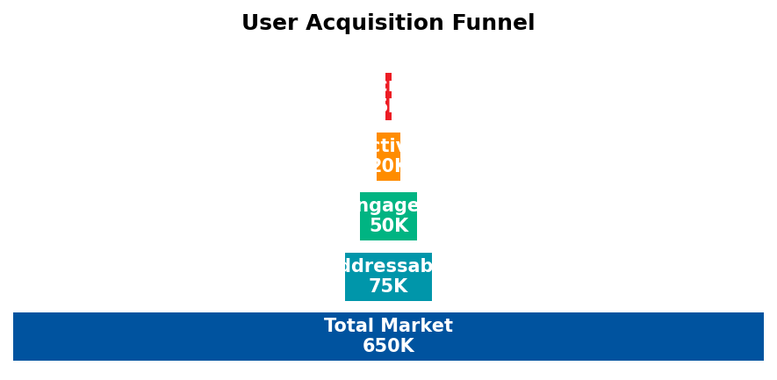
MediChain — Tech-enabled Primary Care & Diagnostics
AI Symptom Triage
Vernacular chatbot
Triage <₹20
IoT Diagnostic Kiosks
BP, ECG, SPO₂, sugar
~₹1L per kiosk
🤖
📊
Blockchain Records
NDHM aligned
Secure, portable
Phygital Linkages
Local pharmacies
Last-mile delivery
🔐
🏪
🎯 KEY DIFFERENTIATORS
✓ Vernacular-first UX for mass adoption
✓ Affordable: <₹100 consults, ₹499/year family plan
✓ Trust via pharmacy kiosks + NGO/govt tie-ups
MediChain = vernacular, trust-first, affordable healthcare disruption.
Presented By — Nakul Nandanwar, Vaishnavi Bhangale, Rahul Kumbhare

Slide 5
Scalable Impact Pathway
MediChain balances profitability with social good, delivering both sustainable returns and healthcare access at scale.
💰 ECONOMIC IMPACT
🌍 SOCIAL IMPACT
• Subscription revenues: ₹499/year per family
• 100M+ underserved gain access by Y5
• Lower out-of-pocket burden for patients
• Preventive health adoption increases 5x
• Scalable unit economics with kiosk model
• Mental health stigma reduction
• Break-even in 18 months per district
• Women's health focus (50% users)
• 35% EBITDA margins at scale
• SDG-3 alignment: Good Health for All
📈 5-YEAR GROWTH ROADMAP
Y1
Y2
Y3
Y4
Y5
PILOT
100 kiosks
50K users
5 districts
EXPAND
500 kiosks
300K users
3 states
SCALE
2500 kiosks
1M users
25 cities
GROWTH
10K kiosks
10M users
100 cities
NATIONAL
50K kiosks
100M users
Pan-India
Scalable, sustainable, socially impactful disruption for Bharat.
Presented By — Nakul Nandanwar, Vaishnavi Bhangale, Rahul Kumbhare

